Slide 1
Say Yes! Creatively Matching Volunteer Interest & Skills with Community & Agency Need June 1, 2015 by Meg Licht Volunteer Services Program Manager at Ethos
Notes:
I work for Ethos
Mission
Quick overview of volunteer roles
My background
I’ve been a volunteer
VISTA Started volunteer program in AL
I want this presentation to be more informal and interactive– feel free to raise your hand with questions and jump in to discuss these ideas at any point!!

Slide 2
SAY YES! Creatively Matching Volunteer Interest & Skills with Community & Agency Need
Maximize the impact of volunteer interest!
Learn to think outside of the box in matching volunteers and volunteer groups with roles in your agency, especially those who may not be a perfect fit for your agency’s set volunteer positions.
Notes:
Maximize the impact of volunteer interest!
Learn to think outside of the box in matching volunteers and volunteer groups with roles in your agency, especially those who may not be a perfect fit for your agency’s set volunteer positions.
By identifying the unique goals, skills, and interests of each volunteer or volunteer group and by thinking critically about the needs of your community and agency, you can connect more volunteers with your agency, increasing your capacity to make a difference.

Slide 3
Ethos’ Volunteer Programs
1970 group volunteers and 568 individual volunteers
41,040.5 hours of service
This past year, volunteers have donated $1,141,746.71 – OVER one million dollars
Notes:
I work for a non profit and we always have limited time and resources!
I need to - as I’m sure you do – maximize my time. I do not have the time or energy to train, screen, and place a volunteer who is going to quit in three weeks because they are not a good fit for their position, or their position is not exactly what they were looking for!
Like I’m sure yours do, my agency constantly has unmet needs, both in terms of programs and client services as well as in our administration.
While we, of course, have set volunteer roles that we are looking to fill, Ethos is able to maximize on our volunteer interest by also thinking creatively to placing volunteers is other roles, too. By keeping these unmet needs in mind, I can find placements for prospective volunteers that are a strong fit, and that the volunteer is going to enjoy and excel in.
The Independent Sector currently values a volunteer hour in Massachusetts at $27.82.
There is no way that Ethos would be able to engage all of these volunteers, or bring in all these hours of support, by only placing volunteers in our set roles!

Slide 4
Presentation Goals
By the end of this presentation, I hope that you will be prepared to….
Identify goals, motivations, and skills of new volunteers
Continually evaluate the needs of your agency and community
Match volunteers with creative projects or roles!
Notes:
Identify the personal and professional goals, motivations, and skills of prospective volunteers and volunteer groups
Continually evaluate the needs of both the agency and community at large and target areas for growth and development
Match volunteers with creative projects or roles which capitalize on their skills and interests and serve an unmet need in the community or agency

Slide 5
Part One: Identifying Volunteer Motivation & Skills
Notes:
Identifying Volunteer Motivation and Skills (about 25 minutes)
Key interview questions,
Tips for reading “between the lines” in interview responses
How to effectively communicate volunteering options to prospective volunteers and groups
Questions & discussion
Small group activity: sample volunteers

Slide 6
Interview Tips
Get the volunteer talking!
Ask open-ended & follow-up questions
Follow up on “red flags” – looking for work, required community service, possible life changes, scheduling conflicts
Be direct
Assess skills & hobbies
Notes:
Before jumping here, I want to give you some context on how our volunteer process works at Ethos, as your agency may do things differently.
We have many set volunteer roles that we are constantly recruiting for, most of which are individual and working in the community directly with elders – generally in their own homes! Most of our roles also require a 6 month minimum commitment. FV or SH – for example
We recruit volunteers in many different ways, but my first point of contact with a new volunteer is usually via email – either the volunteer applies online directly though our website or they respond to any one of our online volunteer recruitment postings (Volunteer Match, Idealist, etc.). I also field calls, too. After this contact, I host volunteer interviews/orientations one-on-one, and have the new volunteer come to my office to meet with me. I usually do around 15-20 interviews per month!
This helps me really get to know the volunteer, and I use this interview as a test to see how they will do when they are going out in the community to volunteer on their own! (As I mentioned, most of our set volunteering roles place the volunteer in the community without direct staff support – although I’m always a phone call away!)

Slide 7
Sample Interview Questions
Tell me about what brought you to be looking to volunteer at this time and why Ethos seems like a good fit for you?
Have you ever worked with or had personal relationships with seniors before? If so, tell me about it! If not, tell me why working with seniors interests you at this time.
Are there any special talents, skill or hobbies that you are looking to use in your volunteer experience?
What type of volunteer commitment are you looking for in both frequency and duration?
What does your weekly schedule look like?
What form of communication works best for you? Email, phone, letter?
Notes:
As you can see, this isn’t very many questions! Again, I really try to keep the volunteer talking! I always ask follow up questions as they talk, however.
Example – A volunteer talking about starting graduate school in a month…I would ask about what they are going to studying and why (to get to know them and their motivations better) and how this will change their schedule. Are they looking to continue volunteering after starting school or just volunteer until they start?

Slide 8
“Reading Between the Lines” in Volunteer Interviews
Use the interview as a test
Can they arrive on time?
Can they call if they are running late?
Appropriate dress?
Can they follow instructions?
Language skills
Body language!
Eye contact?
Notes:
Follow instructions – PARKING
Body language - What they don’t say is just as important as what they do say!
Watch for what they show enthusiasm for – where their face lights up
Example – often volunteers will tell me about a meaningful relationship they have had with a grandparent or other elder…when I see them smile or become emotional during this conversation I know that the population really has meaning to them and their interest is well thought out!

Slide 9
Communicating Volunteer Options
Be clear and direct
Have stock language ready for email communication
Anticipate questions/concerns
Learn from your mistakes! Update language and training materials to reflect new experiences!
Notes:
In my experience, no matter how badly you need a volunteers in a certain role, it can be much worse to try and “fit a square peg into a round hole,” so to speak. I have found that it is best to be direct and clear about volunteers roles might – or might not – be a good fit for a volunteer, and explain why.
Examples – Maggie from Sommerville volunteering in Mattapan – am now clear about area
- OMB volunteer who works full time – am clear about time commitment and training schedules
This is especially important as you work to place volunteers in new and creative roles. Be honest! Tell them that this is something new and you don’t have every detail figured out yet, but that you think they would be the perfect fit to solve this need.” Tell them what you do know about the idea AND what you don’t know.
Example – MSW student – Sarah – updated our volunteer training manual last year to include additional resources on working with elders who may have Alzheimer's disease, dementia, anxiety, or depression. When she came to me looking for a project, I had this idea in mind and told her. I also told her that I did not have a much vision beyond the idea – that I would be here to help her but that she would need to work independently to source content and to create a structure.

Slide 10
Sample Volunteers
Small Group Activity – 10 minutes:

Slide 11
Part Two: Community & Agency Need
Notes:
Identifying Community and Agency Need (about 25 minutes)
How to target new volunteer projects and roles using client surveys, program evaluation and the creation of “spin-off” programs, and “listening between the lines” in conversations with co-workers and community stakeholders.
Questions & discussion
Small group discussion/brainstorm session

Slide 12
Client Surveys
Administered by other staff or volunteer – not by you!
Comments for improvement that Ethos has acted on:
Home Repair
Medication reminders
More accessibility in being able to connect volunteers
Notes:
In addition to this formal process, I am constantly evaluating our programs, an possible gap in our programs, informally.
Listen to your clients and make notes of their feedback!
Home repair is a great example. We were hearing this need/Peter came to us looking to use his skills!

Slide 13
Volunteer Feedback
Constantly evaluate your programs!
Be clear in orientation about how to provide feedback
Be accessible!
Keep lines of communication open
Be sure volunteers feel heard
Notes:
I collect volunteer feedback on a constant and ongoing basis.
On example of how I do this is through our “Client Weekly Reports.” Each month I ask our volunteers who are working one-on-one with clients to share with me a few notes on how things are going. This gives them the opportunity to let me know if they are having a problem or if something can be improved!
Because we have so many volunteers out “in the field,” and I’m not necessarily seeing them on a regular basis, I also am very clear in training about the importance of communication. I actually say “if you remember one thing from today, remember that communication is key. I am here to support you in any way that I can, but it is your responsibility to let me know how I can help!” I also outline the best ways to reach me for the quickest response.
I take notes and keep an ongoing list of needs that could possibly be filled by other volunteers. For example, I had a volunteer tell me that her client in the Friendly Visiting Program constantly asks for help

Slide 14
“Spin Off” Programs
Consider feedback on existing programs, from both clients, current volunteers, and staff
Could materials be created/updated for a current program?
Could a current program benefit from a new structure/location/setting?
Is a current program looking to reach out to additional clients/a new demographic?
Notes:
This is where you take an existing program and, while still running the existing program, twist it around to enhance the offering.
Here’s an example to show what I mean by this - IN HOME COMPUTERS
Partner with local HS to teach on their computers in their lab
Seniors telling us they need help on their own computers at home
Still run the lab program, but now also have volunteers go into the home
- materials – Manual from NEU
- structure/location/setting – group to individual, school to in-home
- new demographic – individuals with disabilities, individuals who are home bound

Slide 15
“Spin Off” Programs - Examples
Materials:
Training manuals
In office-system updates
New structure/location/setting:
In-home vs. central location
One-on-one vs. group program
Short term vs. ongoing program
Additional clients/a new demographic?
Utilize language-skills
Creation of outreach materials
Flyering
Research!
Notes:
Materials
Sarah’s Volunteer Services Manual Update
Fiona paper files to computer files
Location/Setting/structure
FV to Organizational projects – Iris and her papers
Additional Clients/New Demographic
Robin – translating client recruitment materials and program packets into Spanish
Research – Say I want to recruit volunteers who speak Haitian Creole – have a volunteer research local Haitian community centers and orgs and hand me a list of contacts to start the process
Translation of flyers and client communication materials – Robin

Slide 16
“Listening Between the Lines”
Make yourself available around your agency – strike up conversations with co-workers!
Keep your “ears open” for staff needs!
Formal or informal staff surveys
Keep a running list of possible needs
Notes:
Informal survey – simple email or in conversation
- example – emailed our home care staff when I had TR volunteers vailable/ volunteer with MassHealth expertise
Running list – nothing fancy! I use the post-it feature on the windows browser
Could use a real post it or legal pad
Simple word doc
I refer to this list in volunteer interviews all the time!
I also keep a list of all volunteers I have connected with – can refer back and try reaching out again if looking to fill a specific need!

Slide 17
Formal Staff Surveys- Examples
Could a volunteer help to support your administrative work in the office? How?
Is your program starting any new initiatives in the near future?
Do you feel short-staffed? Is there a project we could transfer to an intern or volunteer?
Have you seen any new/unmet needs among your clients?
Notes:
Do not expect full participation! Your staff are busy…consider this just a way of getting some ideas and showing your staff that you are looking for ideas!
Once per year or every 6 months

Slide 18
Know Your Agency
What are your agency’s priorities and what is your agency’s mission?
Anticipate changes to priorities
Be prepared for new initiatives
Notes:
Be prepared for your volunteer recruitment to follow these trends!

Slide 19
Community Needs
Think outside of your agency, too!
Listen to clients talk about their lives outside of their affiliation with your agency. Is there a need that you can meet with a volunteer or group?
Stay current! Follow news pieces and current research relevant to your community or your clients.
Might this volunteer be a great fit for another agency that you know of? Share information and make referrals!
Notes:
Listen - Home repair, snow shoveling, computers, health fair
Stay Current - AgeWell!!!
Referrals – need to know your sphere of influence and other community agencies in your area/serving your population
Refer to them and they will refer back to you!
At the end of the day, I would rather have a volunteer find a fulfilling role that they will enjoy and stick with to serve another client at another agency rather than forcing hem into a role at Ethos that they won’t like or last in!
- Rogerson – volunteer for arts and crafts
- GI – referred volunteer who wanted to work with kids, got a volunteer for meal sites

Slide 20
Brainstorm & Discuss!
Group Activity:
Notes:
I would love to open the floor to discuss some real needs in your own agencies and communities. My hope is that we can take a few minutes to work together to find ways to fill these needs!
My example: New Interns – need training materials ready!

Slide 21
Part Three: Putting it all Together with Case Studies
Notes:
Putting it all together – Case Studies – 25 minutes
Case Study: Ethos’ In-Home Computer Training Program
Case Study: Ethos’ Greeting Card Program
Case Study: Ethos’ BMMP Internship Program
Strategies for gaining support from agency and community stakeholders
Strategies for ensuring effective management of these placements
Questions & discussion

Slide 22
In-Home Computer Training Program
CHALLENGES:
While Ethos offers group computer classes to local seniors, participants wanted help using their own computers.
Many volunteers want a short term role (cannot commit to serving for 6 months or more)
Many volunteers are eager to use their technological skills to help others.
Notes:
While Ethos offers group computer classes to local seniors, we received feedback that participants wanted help using their own computers.
We see many volunteers who are interested in working with Ethos on a short term basis and cannot commit to serving for 6 months or more (our usual minimum commitment). We also encounter many volunteers eager to use their technological skills to help others.

Slide 23
In-Home Computer Training Program
SOLUTION:
Volunteers visit seniors in their homes, one-on-one, and coach them on computer skills.
The program is structured in six visits, one one-hour long visit per week.
Notes:
This program allows us to fill a need for our clients and engage volunteers who might not otherwise be able to work with Ethos.

Slide 24
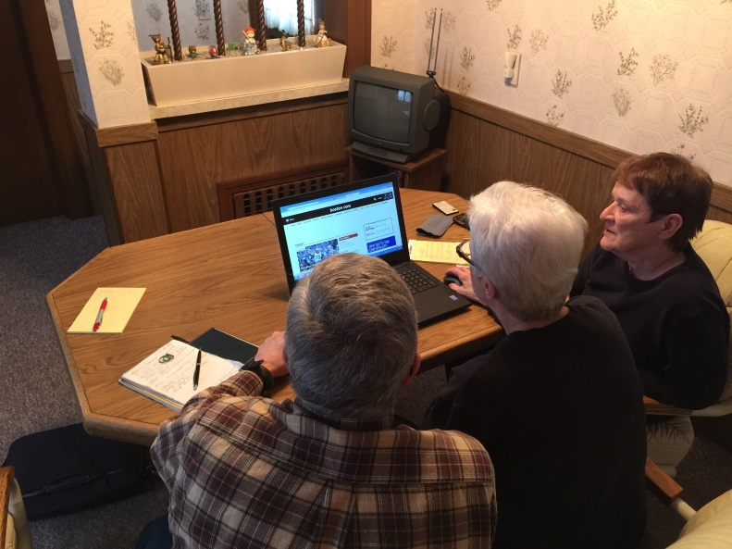
“I do this because it makes me feel good,” Chuck Furgason explains. His work keeps him informed of latest technology!
Mary Lou and Dale are two clients of Chuck’s clients say, “He’s wonderful, he’s patient… Chuck is great.”

Slide 25
In-Home Computer Training Program – Part Two!
CHALLENGES:
Volunteers in Ethos’ In-Home Computer Training Program asked for print resources
Seniors often had trouble remembering lessons from visit to visit
Northeastern University’s engineering program wanted to work with Ethos!

Slide 26
In-Home Computer Training Program – Part Two!
SOLUTION:
Notes:
Northeastern students created a manual for the program!
We are just starting to use it now, but volunteers have told me that they feel more prepared in visiting clients and more professional. Also, their visits are more productive because they do not have to stop to take notes!

Slide 27
Boston Money Management Internship Program
CHALLENGES
Overwhelmed by requests from students seeking internships.
internships generally last only one semester and the students are often most interested in working in our office
Ethos’ Boston Money Management Program (BMMP)has a long list of clients waiting for services
BMMP conducts frequent audits of documentation
Notes:
Explain BMMP!
A note on interns – this is a great place to think creatively! An internship does not necessarily mean sitting at a desk – and internship could mean that the student serves in one – or a combination – of your set roles during the semester!
WAITLIST -
Chronically difficult to recruit volunteers – low-income neighborhoods, clients with MH challenges

Slide 28
Boston Money Management Internship Program
SOLUTION
Client Service Coordinators
In-office – file and audit work
Visit with waitlisted clients until they are matched with an ongoing volunteer
Ethos is able to engage with more schools and individual interns, serve clients who would otherwise be without assistance, AND maintain accurate and detailed programmatic records!
Notes:
Explain BMMP!
Had to tweak their service model, but are now able to keep clients served despite challenge with volunteer recruitement

Slide 29
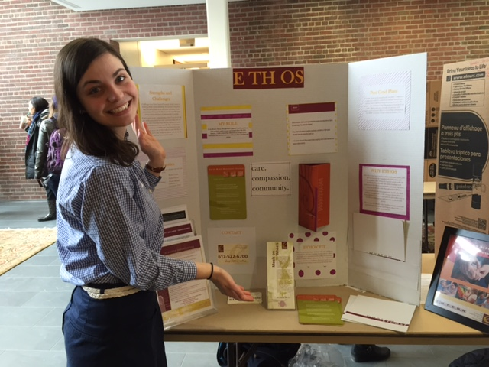

Slide 30
Greeting Cards for Meals on Wheels
CHALLENGES:
Ethos receives many requests from volunteer groups who would like to work with the agency to lead a one-time project on a specific date, or even support the agency from a remote location (i.e. an on-campus school project)
Ethos runs a Meals on Wheels program serving 900 elders, many of whom are isolated or ill.

Slide 31
Greeting Cards for Meals on Wheels
SOLUTION
We engage groups in creating handmade greeting cards for various holidays throughout the year that we send out with our meals
Our meals recipients tell us time and again that the cards brighten their days and Ethos is able to share our work and mission with thousands of additional volunteers each year!
Notes:
Without this opportunity, I would have to say no to SO MANY groups looking to volunteer with Ethos. In the past year alone, over 4,000 greeting cards were made by over 1,500 volunteers!
Charles River Center, College Days of Service, Toddler Tuesdays
Presentation or letter to volunteers – share mission and how to stay involved!!
Having such an opportunity is especially important when funders and possible funders are looking to engage with your agency.
BNY Mellon, THPF
Also a great way to ease a volunteer’s transition into the agency – a great way for volunteers to “get their feet wet”
- Fiona – cards through school and Audrey AND office

Slide 32
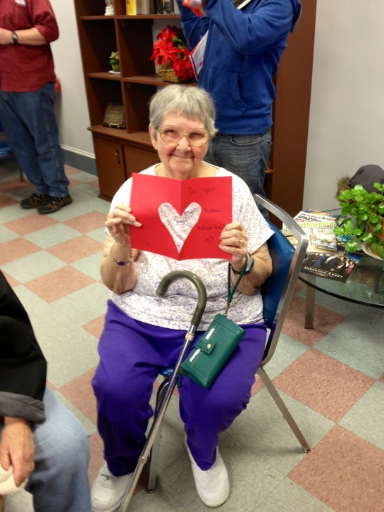
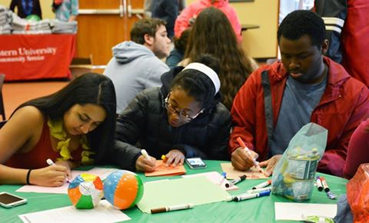
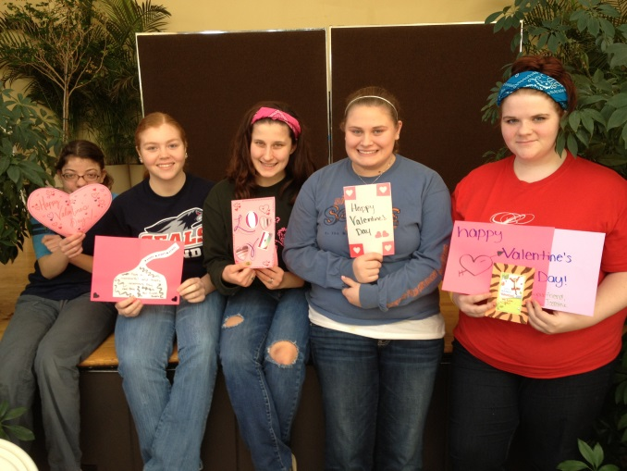
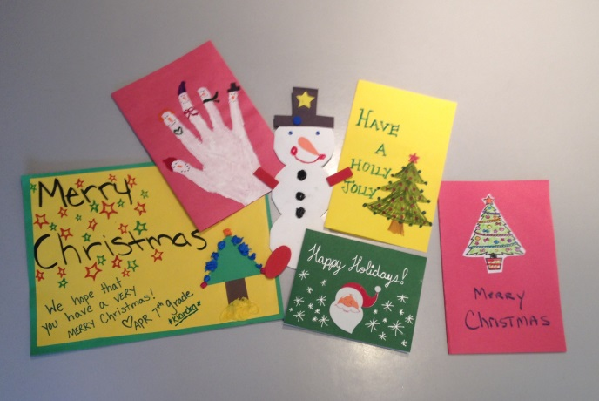
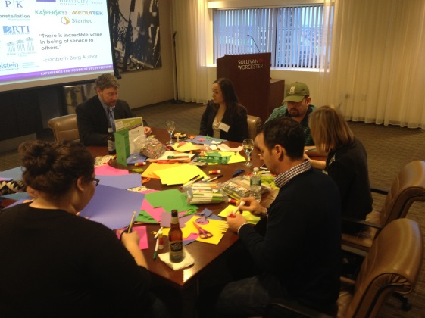
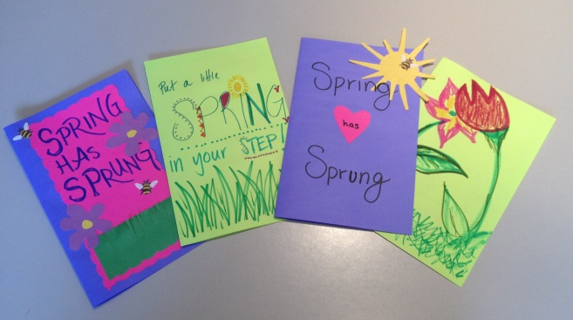
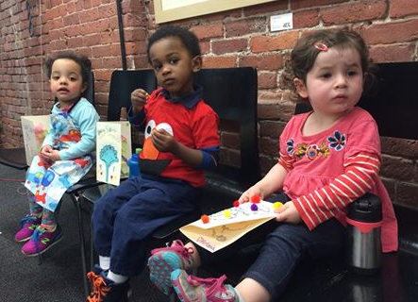
Notes:
Mention Newspaper Article!
Point out all different group – toddlers, high school, corporate

Slide 33
Wrap Up
Connect with more volunteers
Fill needs in programs and services
Engage & accomplish more!

Slide 34
Questions? Comments?
Meg Licht Volunteer Services Program Manager at Ethos 555 Amory Street Jamaica Plain, MA 02130-2672 T: 617.522.6700 x323 mlicht@ethocare.org www.ethocare.org
Notes:
Follow us on Facebook and Twitter at the handle @ethocare!

